Slide 1
Natural Language Processing for Information Extraction
Rashmi Jakkani

Slide 2
Discussion topics:
Introduction
Information Extraction Tasks
State of the Art-Methods in Information Extraction
Integrating Information Extraction (IE) with Information Retrieval (IR) Systems
Applications of Information Extraction
Current Challenges and Future Research
Conclusion

Slide 3
Introduction:
Natural Language Processing uses computational methods to process the information in spoken or written form of such free text data which acts as a mode of communication commonly used by humans.
There are lot of processes involved in the pipeline of Natural Language Processing.
At the syntactic level, statements are segmented into words, tokens and each token is assigned with its label in the form of noun, verb, adverb, adjective and so on.
At the semantic level, each word is analyzed to get the meaningful representation of the sentence.
Hence, the basic task of NLP is to process the unstructured text and to produce a representation of its meaning. The higher level tasks in NLP are Machine Translation (MT), Information Extraction (IE), Information Retrieval (IR), Automatic Text Summarization (ATS), Question-Answering System, Parsing, Sentiment Analysis, Natural Language Understanding (NLU) and Natural Language Generation (NLG).

Slide 4
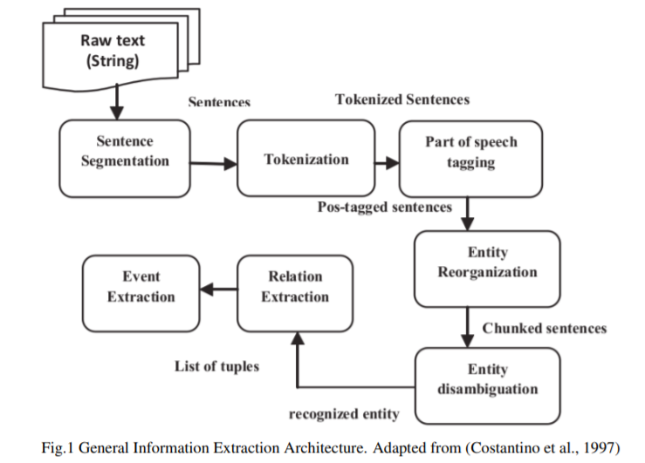
Information Extraction Tasks:

Slide 5
IE Tasks in detail:
Parts of Speech Tagging
Parsing
Named Entity Recognition (NER)
Named Entity Linking (NEL)
Coreference Resolution (CR)
Temporal Information Extraction (Event Extraction)
Relation Extraction (RE)
Knowledge Base Reasoning and completion

Slide 6
1. Parts of Speech Tagging:
Part-of-Speech tagging approaches can generally fall into two categories:
Rule based approaches :
Statistical approaches:
Recently, deep learning based Part-of-Speech tagging has gained momentum
2. Parsing:
These are divided into 2 categories based on their underlying grammatical formalism.
Constituency Parsing:
Dependency Parsing:

Slide 7
3. Named Entity Recognition(NER):
Example: Michael Jordan lives in United States.
NER system extracts Michael Jordan which refers to the name of the person.
And United States which refers to the name of the country.
4. Named Entity Linking(NEL):
NEL is also known as Named Entity Disambiguation or Named Entity Normalization.
Example: “Paris” can refer to entity mention location i.e (capital of France) or It can refer to entity mention person i.e Paris Hinton (An Actress)
5. Coreference Resolution(CR):
Example: I have seen the annual report. It shows that we have gained 15% profit in this financial year.
Here, I refers name of the person,
It refers the annual report and
we refers name of the company in which that person works.

Slide 8
6. Temporal Information Extraction(Event Extraction):
Example: President Barack Obama yesterday addressed the issue of nuclear deals at white house.
Here, yesterday refers noun phrase which refers to temporal information
7. Relation Extraction(RE):
Example: Jodie Foster is an American Actress who won Academy award for movie “The silence of the Lambs”.
Here, we can extract fact such as won i.e (Jodie, Academy award)
8. Knowledge Base Reasoning and Completion:
The goal of link prediction (also known as Knowledge Base Completion) is to determine the relationship between entities. There are various applications based on link prediction such as recommendation systems, Knowledge base completion and finding links between users in social networks

Slide 9
State-of-the-art-methods in Information Extraction:
The most important IE systems competitions are Message Understanding Conferences (MUC) starting with MUC-6 competition.
The various approaches used in IE are broadly categorized into three main categories:
1. Pattern matching based approach
2. Gazetteer based approach
3. Machine Learning based approach

Slide 10
4.Information Extraction Tools:
There are various publicly and commercially available tools for Information Extraction.
Public IE tools: GATE(General Architecture for Text Engineering), JULIE, Open NLP (Apache Open NLP -Java machine learning toolkit for NLP), Stanford NER, GExp, Mallet (Machine learning for language toolkit), Natural Language Toolkit (Suite of Python libraries for NLP), DBpedia Spotlight (Open source tool for Named Entity Recognition and Named Entity Linking) and Open Calais (Automated IE web service from Thomson Reuters).
Commercial IE tools: Altensity, Open Calais, ClaraBridge, SAS Text Analytics, Business Objects, IBM Intelligent Minerand, Lingpipe.
Specialized IE tools: Ariadne Genomics Medscan Reader for biomedical documents, RINX for resumes.

Slide 11
Integrating Information Extraction (IE) with Information Retrieval (IR) Systems:
The task of Information Retrieval (IR) system is to provide a list of documents which are most relevant in response to user query.
To overcome these limitations, NLP research community has moved towards integrating Information Extraction technology with Information Retrieval technology to make search engines more reliable, accurate, specific to user queries and having high semantic understanding

Slide 12
Applications of IE:
Resume Processing:
Classified Advertisements:
Customer Services:
Social Analysis:

Slide 13
Current challenges and future research:
Bio IE
Business Analytics
Text IE in Images and Videos
Web Harvesting

Slide 14
Conclusion:
There is considerable excitement in NLP community at the prospects of Information Extraction technology due to rise of social media platforms such as Twitter, Facebook, Instagram, and so on. Social media reacts to world events faster than traditional news sources, and its sub-communities play close attention to topics that other sources might ignore.
Recently, deep learning has been widely used in various areas including Computer Vision, Speech Recognition, and Natural Language Processing.
In NLP tasks, deep learning has been successfully applied to Part-of-Speech tagging (Collobert et al., 2011), Sentiment Analysis (dos Santos and Gatti, 2014), Parsing (Socher et al., 2013), Machine Translation (Sutskever et al., 2014).

